Slide 1
PUFFER :A Routability-Driven Placement Framework via Cell Padding
Zhengtao Wu
Shanghai LEDA Technology Co., Ltd.,
Shanghai 201203, China
Zhijie Cai, Peng Zou, Xingyu Tong, Jun Yu, Jianli Chen
State Key Lab of ASIC & System
Fudan University, Shanghai 200433, China
Yao-Wen Chang
Department of Electrical Engineering
National Taiwan University, Taipei 10617, Taiwan
Presenter : Min-Feng Hsieh
Adviser : Ting-Chi Wang
Notes:
上海鐳達晶元智慧科技有限公司
復旦大學專用積體電路與系統國家重點實驗室

Slide 2
Outline
Abstract
Introduction
Preliminaries
Proposed Algorithm
Congestion Estimation
Cell Padding
Strategy Exploration
Legalization
Experimental Result

Slide 3
Outline
Abstract
Introduction
Preliminaries
Proposed Algorithm
Congestion Estimation
Cell Padding
Strategy Exploration
Legalization
Experimental Result

Slide 4
Abstract
Estimate the congestion by imitating routing detour and clustered cell spreading.
Use the method of cell padding and strategy exploration for optimizing routibility during global placement and legalization stage.
Cell padding considers multiple features, which accumulating accurate congestion.
Apply Bayesian-based method to avoid parameter tuning.
PUFFER achieves best routability with 2.7x (commercial) and 1.4x (Replace) speedups.
Notes:
Placement is critical for the routability optimization.

Slide 5
Outline
Abstract
Introduction
Preliminaries
Proposed Algorithm
Congestion Estimation
Cell Padding
Strategy Exploration
Legalization
Experimental Result

Slide 6
Introduction
Routability-driven placement typically consists of:
Basic placement engine:
Quadratic placement.
Non-linear placement.
ePlace
Routability optimizer:
Congestion map, which is generated by probabilistic model [2], [8], [9], [10], [11].
Integrated global router [3], [4], [5].
Machine learning based technique [6], [7].
Notes:
In quadratic placement, an iterative framework with lower and upper bounds is often applied. The lower bound is described by a quadratic wirelength model to minimize wirelength, and the upper bound is generated by spreading cells in high density regions to remove cell overlaps
In non-linear placement, the objective function is formulated by a non-linear wirelength model subject to a density constraint. By relaxing the density constraint into the objective function, the placement problem can be solved by gradient-descent-based methods to obtain a high-quality placement solution with the desired tradeoff between wirelength and cell density.

Slide 7
Introduction
Congestion map
Spread cells in congested regions by cell inflation and rough legalization.
POLAR 2.0 [8]
Ripple 2.0 [9]
White space allocation [10], [11].
To modify the congestion constraint according to the congestion information [4].
Modeling routing demands or congestion as a new optimizing target and integrating it into the objective function [13].
Notes:
現在很有多方法可以從Congestion map來得到congestion information的

Slide 8
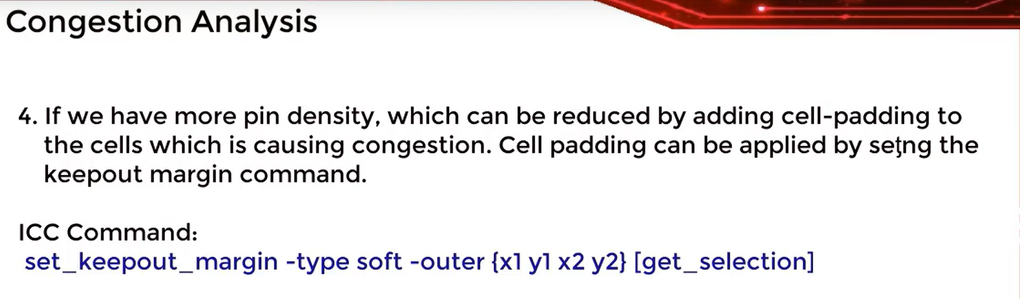

Slide 9
Outline
Abstract
Introduction
Preliminaries
Proposed Algorithm
Congestion Estimation
Cell Padding
Strategy Exploration
Legalization
Experimental Result

Slide 10
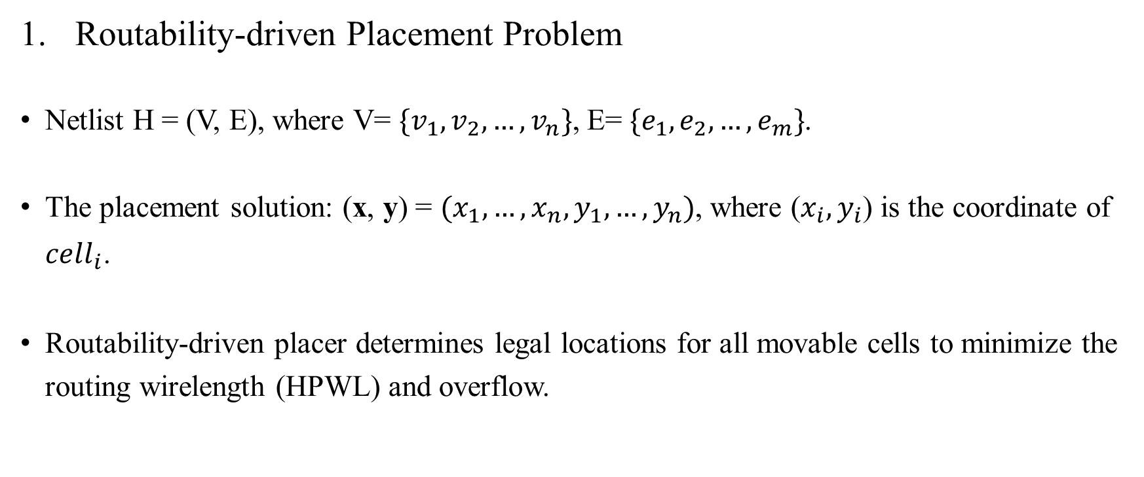
Preliminaries
Routability-driven Placement Problem
Netlist H = (V, E), where V= $\{v_{1}, v_{2}, …, v_{n}\}$, E= $\{e_{1}, e_{2}, …, e_{m}\}$.
The placement solution: (x, y) = $(x_{1}, …, x_{n}, y_{1}, …, y_{n})$, where ($x_{i}, y_{i}$) is the coordinate of $cell_{i}$.
Routability-driven placer determines legal locations for all movable cells to minimize the routing wirelength (HPWL) and overflow.
Notes:
V:cell instance
E: net

Slide 11

Preliminaries
We can formulate analytical global routing problem as:
$$\underset{(x, y)}{\min{f\left(x\right)=}}{W\left(x, y\right)+ λD(x, y)}$$
$W\left(x, y\right):$wirelength
$D\left(x, y\right):$ Density penalty to spread cells
λ : Density penalty factor
Notes:
Λ : to balance the weight between wirelength and density
* * * * * After doing global Placement, we need to legalize the cell positions to remove cell overlaps and DRC violations.

Slide 12
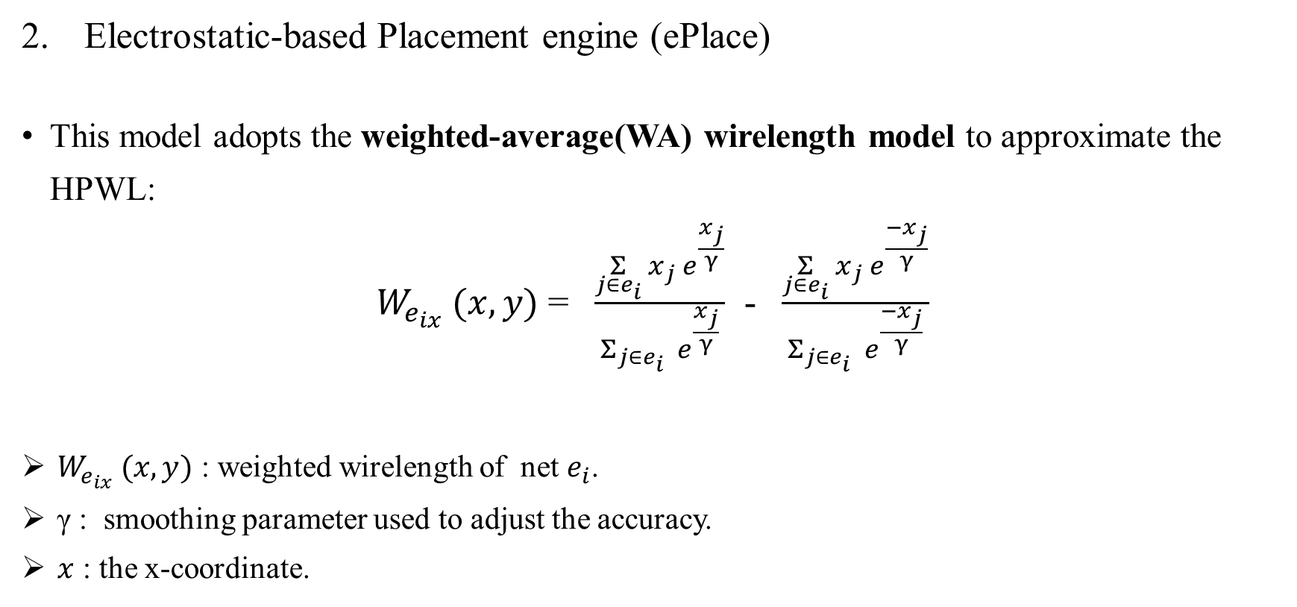

Preliminaries
$${W_{e_{i}} (x, y){ = W}_{e_{ix}} (x, y) +W}_{e_{iy}} (x, y)$$
Electrostatic-based Placement engine (ePlace)
This model adopts the weighted-average(WA) wirelength model to approximate the HPWL:
$W_{e_{ix}} (x, y)$ = $\frac{\underset{j∈e_{i}}{Σ}{x_{j}{ e}^{\frac{x_{j}}{γ}}}}{Σ_{j∈e_{i}}{{ e}^{\frac{x_{j}}{γ}}}}$ - $\frac{\underset{j∈e_{i}}{Σ}{x_{j}{ e}^{\frac{{−x}_{j}}{γ}}}}{Σ_{j∈e_{i}}{{ e}^{\frac{{−x}_{j}}{γ}}}}$
$W_{e_{ix}} (x, y)$ : weighted wirelength of net $e_{i}$.
γ : smoothing parameter used to adjust the accuracy.
$x$ : the x-coordinate.
Notes:
Electrostatic: 靜電
Ei : net
X : ei上cell的x座標

Slide 13

Preliminaries
To get the density penalty, the placement region will first divide into uniform bins by M×M grids.
$$D\left(x, y\right)= \underset{v_{i}∈V,{ v}_{i}∈b_{m,n}}{Σ}{w_{i}h_{i}ψ(m,n)}$$
${ w}_{i}h_{i}$: area of cell i
${ b}_{m,n}$: the bin in row m and column n
$ψ(m,n$) : the electric potential of $b_{m,n}$
Notes:
他會把全部sigma起來，他會iterate所有的cell，並且找到該cell是在哪一個bin中

Slide 14
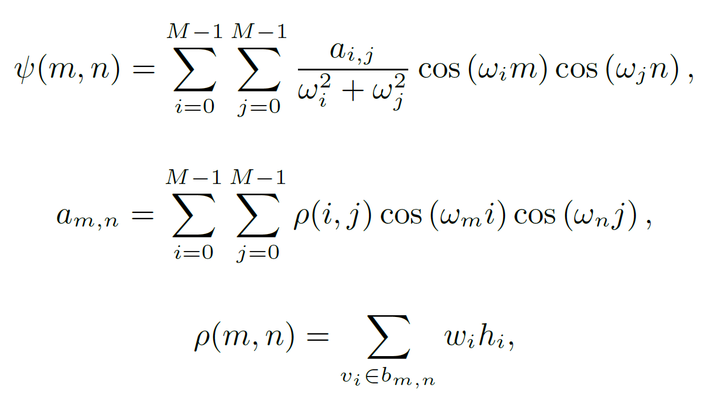
Preliminaries

Slide 15
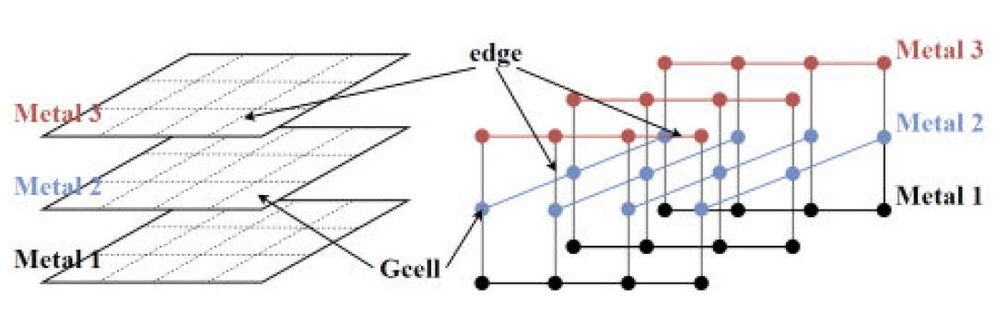
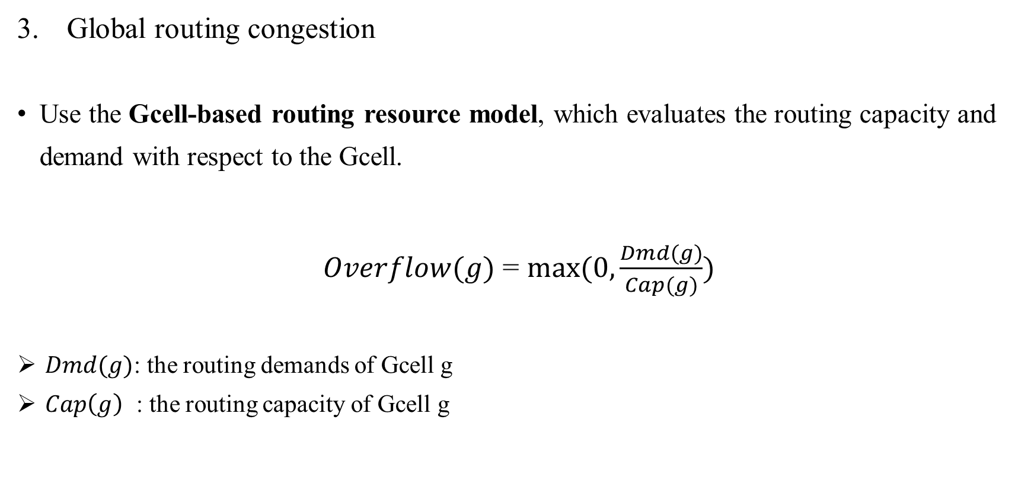
Preliminaries
Global routing congestion
Use the Gcell-based routing resource model, which evaluates the routing capacity and demand with respect to the Gcell.
$Overflow(g)$ = $max⁡(0, \frac{Dmd(g)}{Cap(g)})$
$Dmd(g)$: the routing demands of Gcell g
$Cap\left(g\right)$ : the routing capacity of Gcell g

Slide 16
Outline
Abstract
Introduction
Preliminaries
Proposed Algorithm
Congestion Estimation
Cell Padding
Strategy Exploration
Legalization
Experimental Result

Slide 17
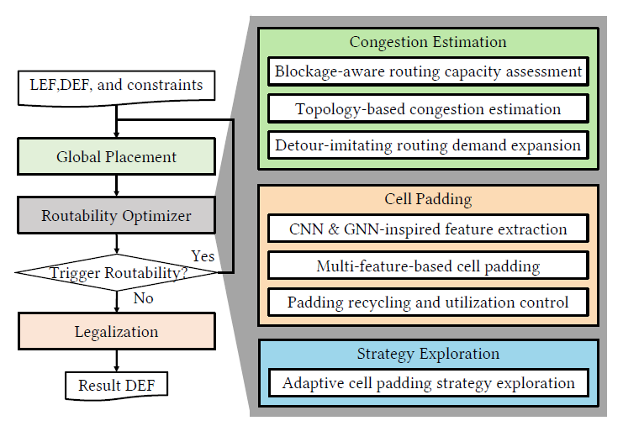
Proposed Algorithm
Notes:
Global placement: 用一些placement engine來spread cells 並且 optimize wirelength (ePlace)
Routability optimizer: 會分析現在的congestion information並且利用cell padding來降低congestion
Legalization: 會消除DRC跟overlap

Slide 18
Outline
Abstract
Introduction
Preliminaries
Proposed Algorithm
Congestion Estimation
Cell Padding
Strategy Exploration
Legalization
Experimental Result

Slide 19
Congestion Estimation
Cells in global placement tend to form bunches of clusters since the placement region is divided into bins by a grid.
Cells in the same grid often overlap severely.
Precise routing solution at this stage less meaningful as the overlapped cells inevitably lead to high routing demand.

Slide 20
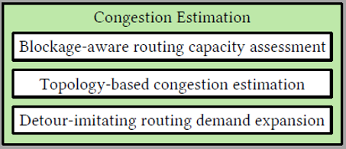
Congestion Estimation
Blockage-aware Routing Capacity Assessment (to estimate routing capacity)
Use a Gcell-based routing resource model, which evaluates routing capacity and demand with respect to Gcells.
Routing capacity includes 1. basic capacity and 2. blocked capacity.
Basic capacity: obtain from tech information (wire width and space).
Blocked capacity: includes pin obstructions, power ground, macros…
${Cap}_{H/V}(g)$ = $\sum_{l.pd=H/V}^{l∈L}{\frac{{GcellLength}_{H/V}}{{MetalWidth}_{l}+ {WireSpacing}_{l}}} − \sum_{b∈Blk}{\frac{{OL}_{H/V} (b,g)}{{MetalWidth}_{b.l}+ {WireSpacing}_{b.l}}}$
Notes:
目的是要找到routing的capacity
CapH=V (g) : the horizontal or vertical routing capacity of Gcell g
l.pd : the preferred routing direction of metal layer l
L : the set of metal layers
Blk : the set of blockages
OLH=V (b; g) is the horizontal or vertical overlaps between blockage b and Gcell g
b.l : the metal layer where the obstacle is located

Slide 21
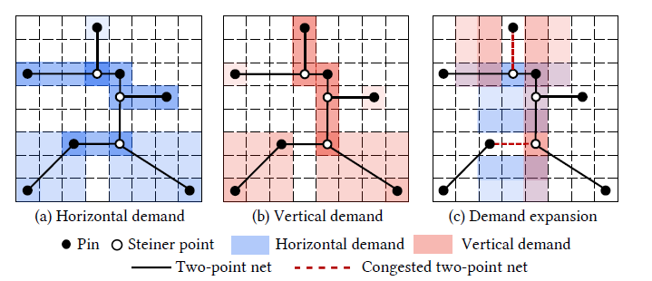
Congestion Estimation
Topology-based Congestion Estimation (to estimate the routing demand)
Use FLUTE to get the RSMT topology of the nets, which divide multi-pin net into two-pin net.
Notes:
1. 如果是I-shape的net (x相等或是y相等): 被這條net經過的gcell會花費一個demand
2. 如果是L-shape的net(x,y都不相等) : 被bounding box圈起來的gcell也會需要花費到demand
3. 如果這條net的Pin都在同一個gcell中，該gcell會得到一個pin penalty demand

Slide 22
Congestion Estimation
Routing detour-imitating Routing Demand Expansion
For all congested I-shape two-point nets, they will try to transfer the original routing demand
to the surrounding region with sufficient routing resources
If contain steiner point: add extra routing demand in the perpendicular direction (routing detour)
If only pins: not necessary, because the cell can be moved (cell spreading)
Notes:
做完這些就會得到congestion map了

Slide 23
Outline
Abstract
Introduction
Preliminaries
Proposed Algorithm
Congestion Estimation
Cell Padding
Strategy Exploration
Legalization
Experimental Result

Slide 24
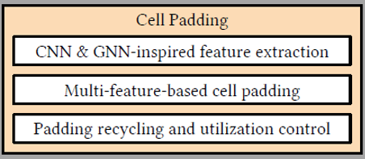
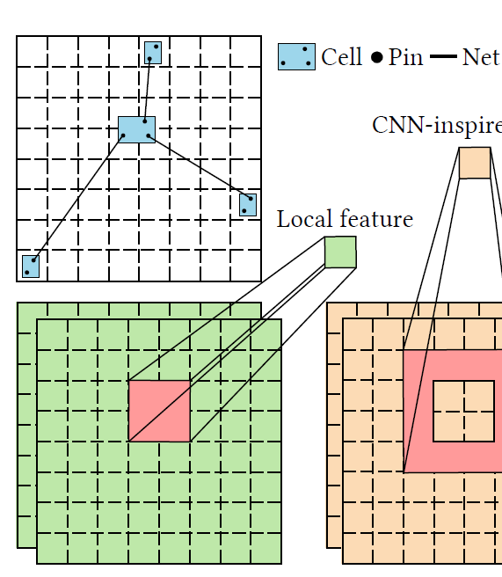

Cell Padding
CNN and GNN-inspired feature extraction
Traditional local information – local congestion
$LCg\left(c\right)$ = $\max_{gεPos(c)}{Cg(g)}$
$LCg\left(c\right)$: the local congestion of cell c
$Cg(g$): the congestion of Gcell g
$Pos(c)$: Gcell set including all Gcells overlapped with cell c
Notes:
前面已經分析出了congestoin map, 接著就要開始提取features了

Slide 25
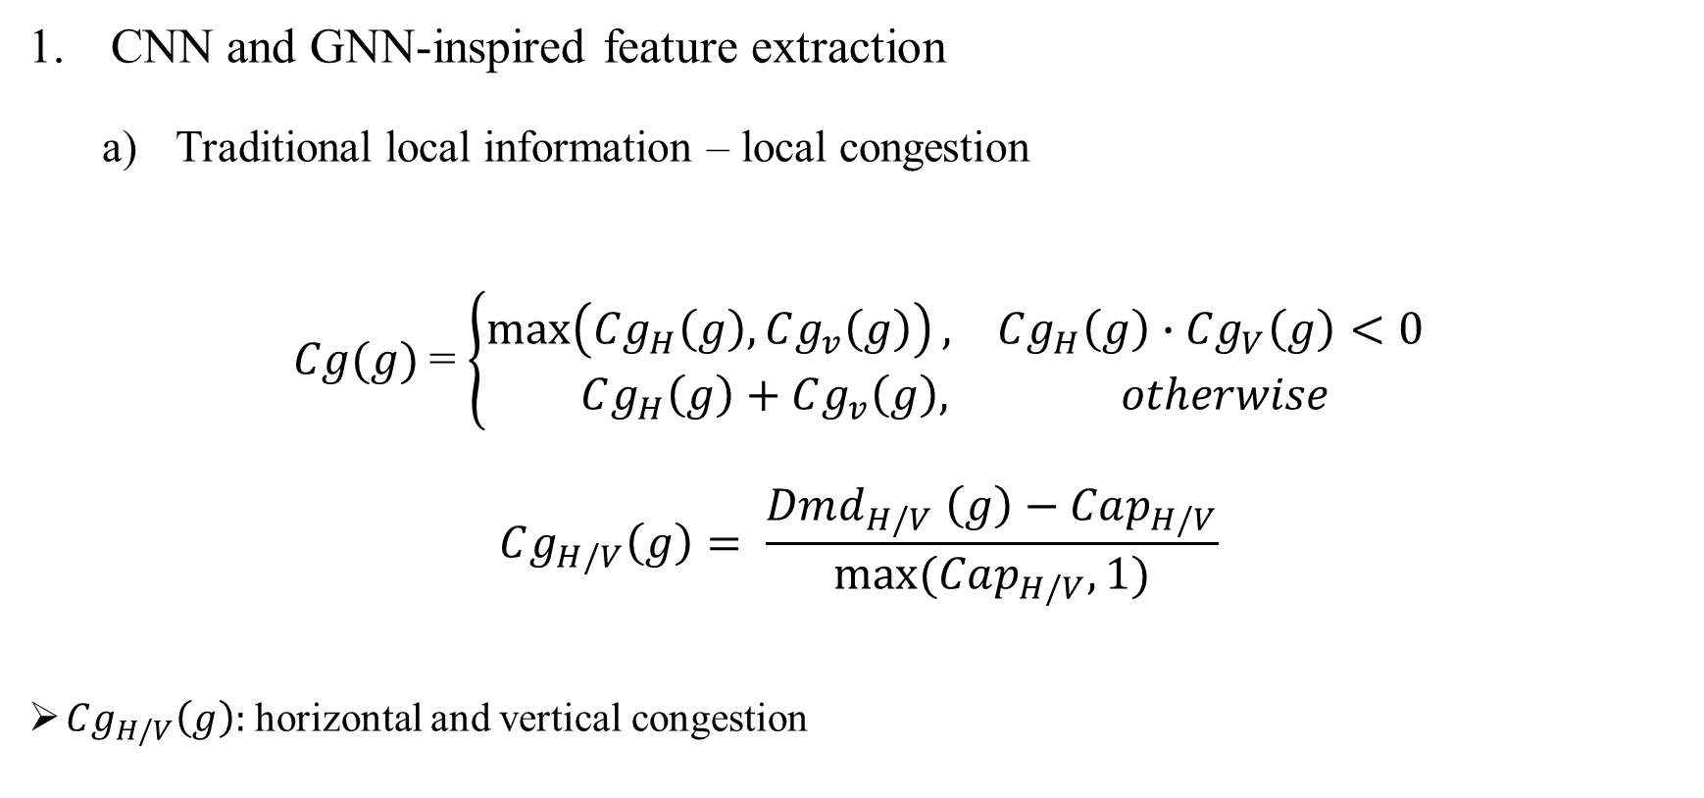
Cell Padding
CNN and GNN-inspired feature extraction
Traditional local information – local congestion
$Cg(g)$= $\left\{\begin{aligned}\max\left(Cg_{H}\left(g\right), Cg_{v}\left(g\right)\right), Cg_{H}\left(g\right)∙Cg_{V}\left(g\right)<0 \\ Cg_{H}\left(g\right)+Cg_{v}\left(g\right), otherwise\end{aligned}\right.$
$$Cg_{H/V}\left(g\right)= \frac{Dmd_{H/V} \left(g\right)−Cap_{H/V}}{max⁡(Cap_{H/V},1)}$$
$Cg_{H/V}\left(g\right):$horizontal and vertical congestion
Notes:
Pos(c) is the Gcell set including all Gcells overlapped with cell c
Cg H/V (g) : horizontal and vertical congestion

Slide 26

Cell Padding
CNN and GNN-inspired feature extraction
Traditional local information – pin density
Pin density(g) = $\frac{number of pins in each Gcell}{Number of available sites in each Gcell}$

Slide 27
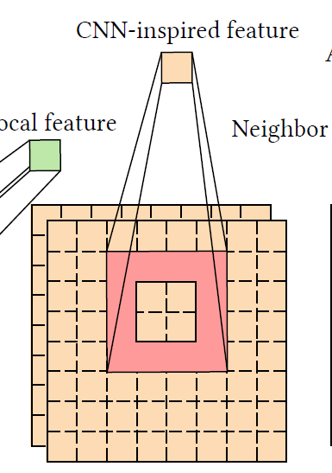
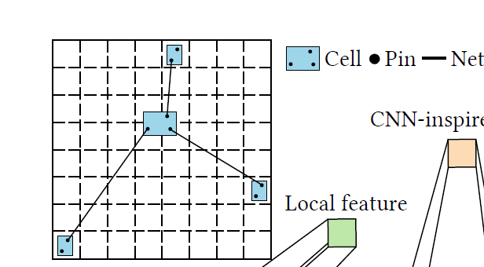
Cell Padding
Surrounding congestion and surrounding pin density (CNN)
To expand a cell’s bounding box vertically and horizontally.
The size of the expanded bounding box equals to the convolution kernel size.
The kernel does the mean filter operation.
Notes:
Cnn在做convolution的時候，kernel 會提取附近的特徵。所以在這邊他會提取附近的congestion跟pin density(因為上一步已經都提取好gcell了congestion跟pin density了)

Slide 28
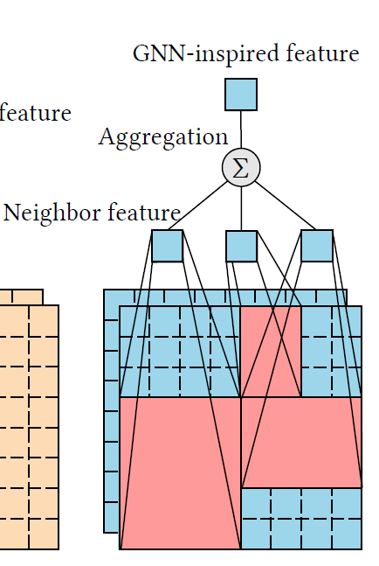
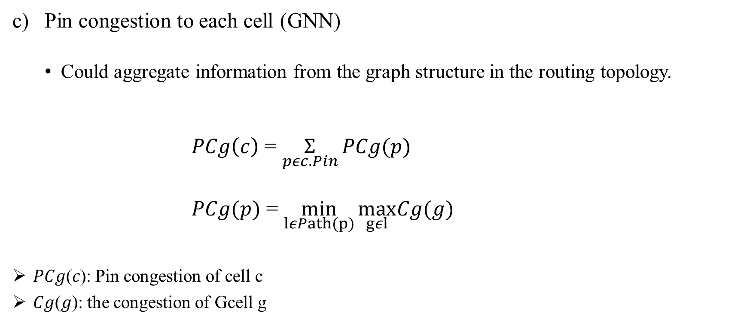
Cell Padding
Pin congestion to each cell (GNN)
Could aggregate information from the graph structure in the routing topology.
$PCg\left(c\right)$ = $\underset{pεc.Pin}{Σ}{PCg(p)}$
$PCg(p)$ = $\min_{lεPath(p)}{\max_{gεl}Cg(g)}$
𝑃𝐶𝑔(𝑐): Pin congestion of cell c
𝐶𝑔(𝑔): the congestion of Gcell g
Notes:
Pin p 的congestion會等於所有p會經過的path l 中該path l會經過的gcell(所有跟pin p有關的two point net)有最大gcells congestion的最小值
C是cell

Slide 29
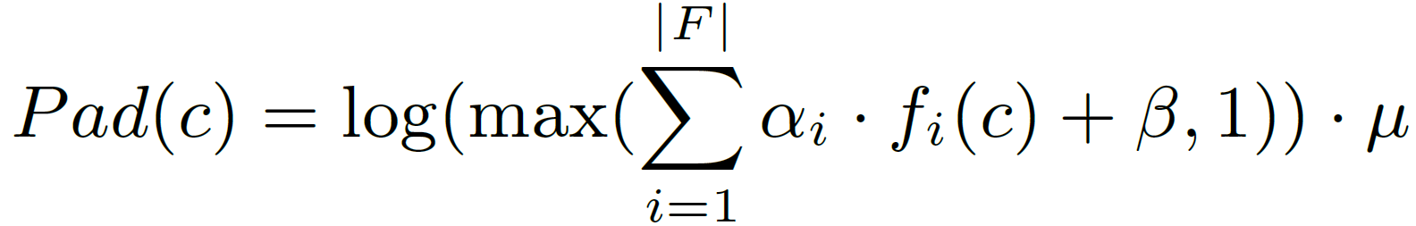
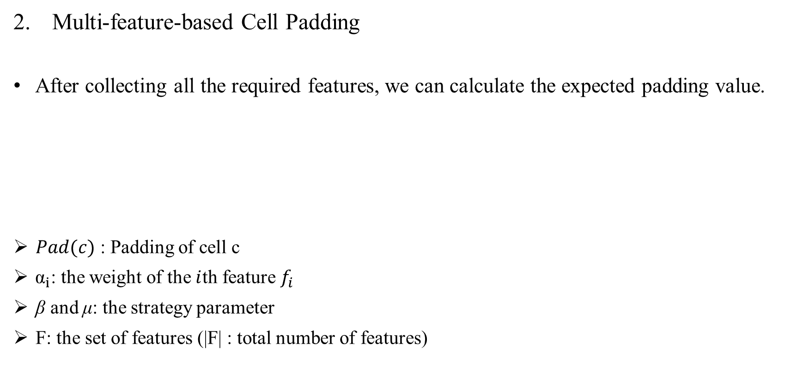
Cell Padding
Multi-feature-based Cell Padding
After collecting all the required features, we can calculate the expected padding value.
$Pad(c)$ : Padding of cell c
${ \text{α}}_{i}$: the weight of the $i$th feature $f_{i}$
β and μ: the strategy parameter
F: the set of features (|F| : total number of features)
Notes:
The logarithmic function 是為了要平滑 padding values的distribution, 進而改善padding process的stability
他的strategy parameter會利用一個方法來找，後面會說到

Slide 30
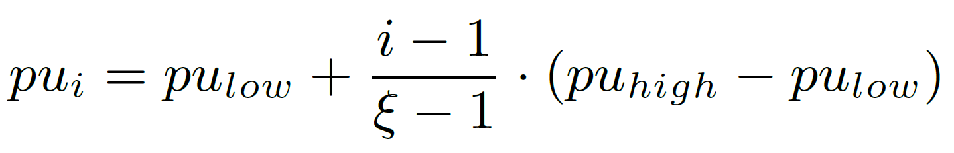
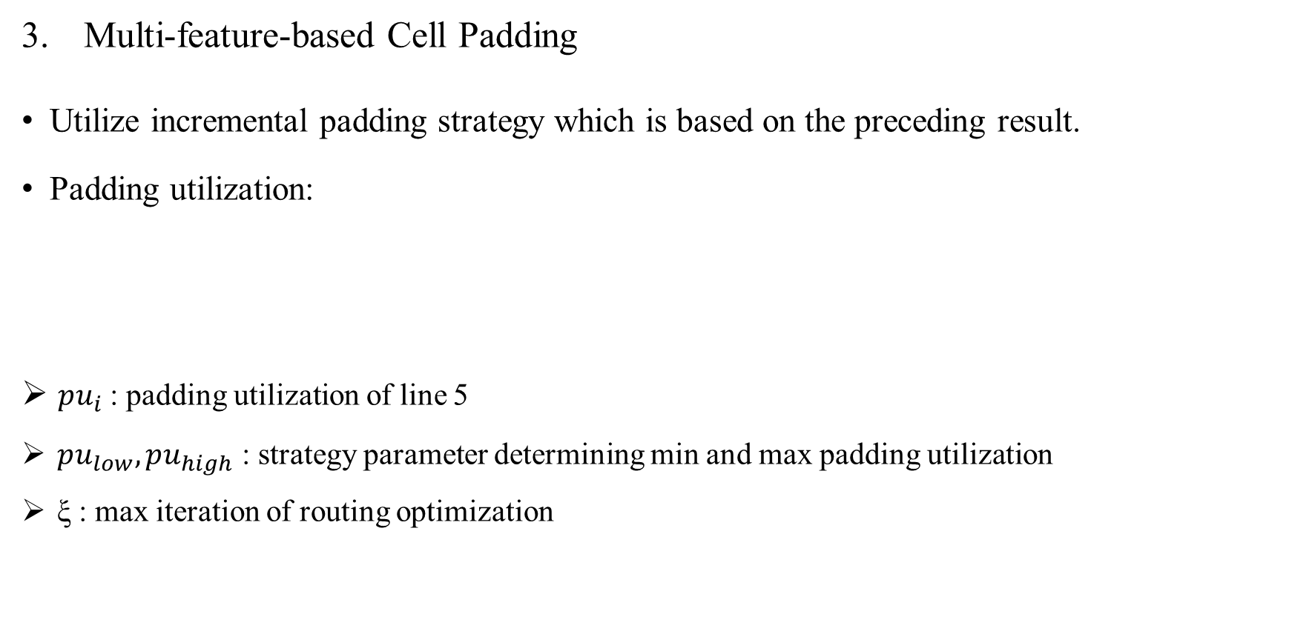
Cell Padding
Multi-feature-based Cell Padding
Utilize incremental padding strategy which is based on the preceding result.
Padding utilization:
$pu_{i}$: padding utilization of line 5
$pu_{low}, pu_{high}$ : strategy parameter determining min and max padding utilization
ξ : max iteration of routing optimization

Slide 31
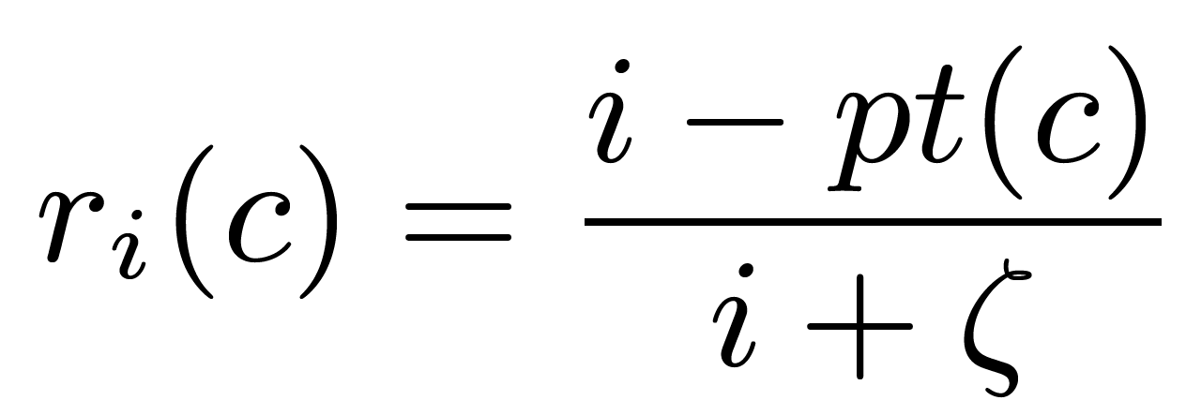
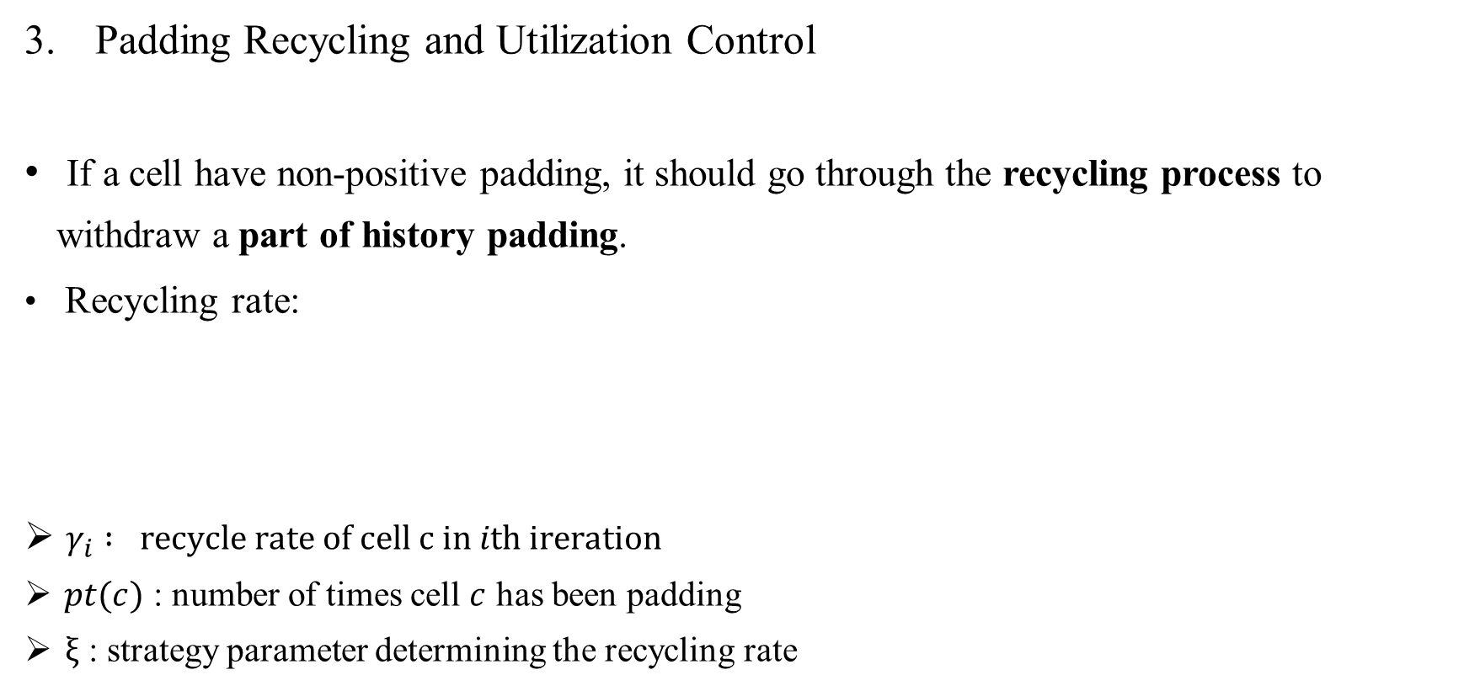
Cell Padding
Padding Recycling and Utilization Control
If a cell have non-positive padding, it should go through the recycling process to withdraw a part of history padding.
Recycling rate:
$γ_{i} : recycle rate of cell c in ith ireration$
$pt(c)$ : number of times cell $c$ has been padding
$ξ$ : strategy parameter determining the recycling rate
Notes:
前面padding的值最小就是1*$μ$
如果他的值是0，就代表不需要padding ->把之前的部分拿掉
因為這樣可以避免一些可能會增加wirelength的padding

Slide 32
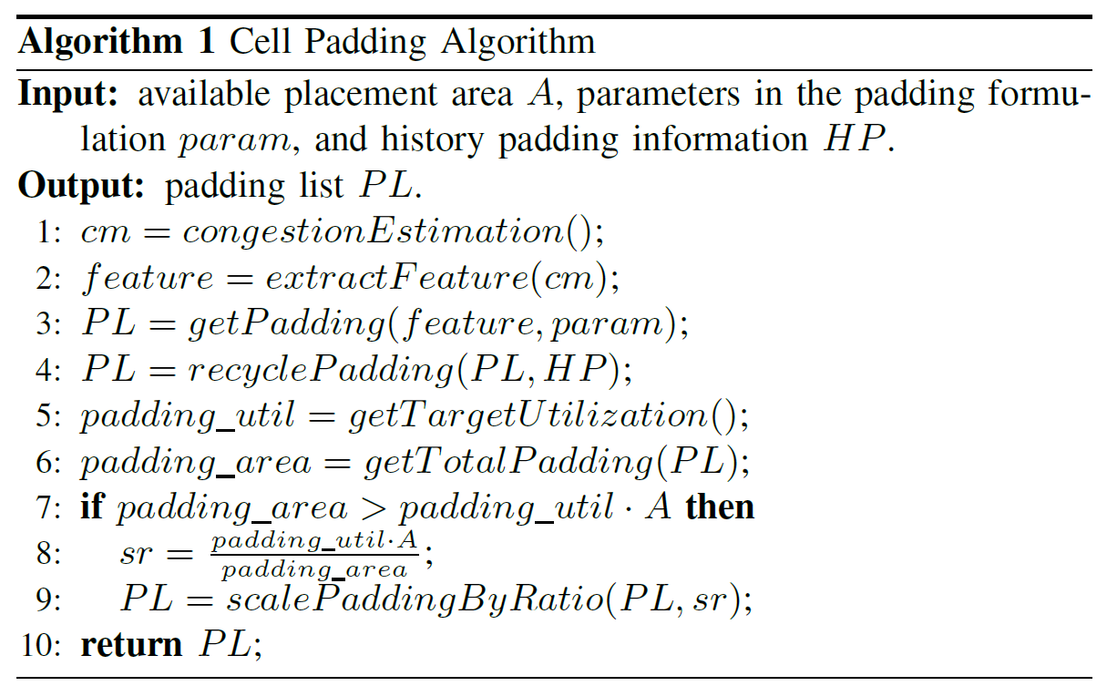
Cell Padding
Multi-feature-based Cell Padding
Routabililty optimization process:
Notes:
因為這樣可以避免一些可能會增加wirelength的padding
1. 估計congestion
2. 從congestion map跟placement information來提取之前講到的3個features
3、4 : 根據剛剛講到的公式來計算padding value跟回收padding
5: 計算padding utilization (控制padding utilization可以避免Over padding, 阻礙後續的優化)
6-9 : 若total padding超過了設定的utilization,那padding會進行縮放來達到constraint

Slide 33
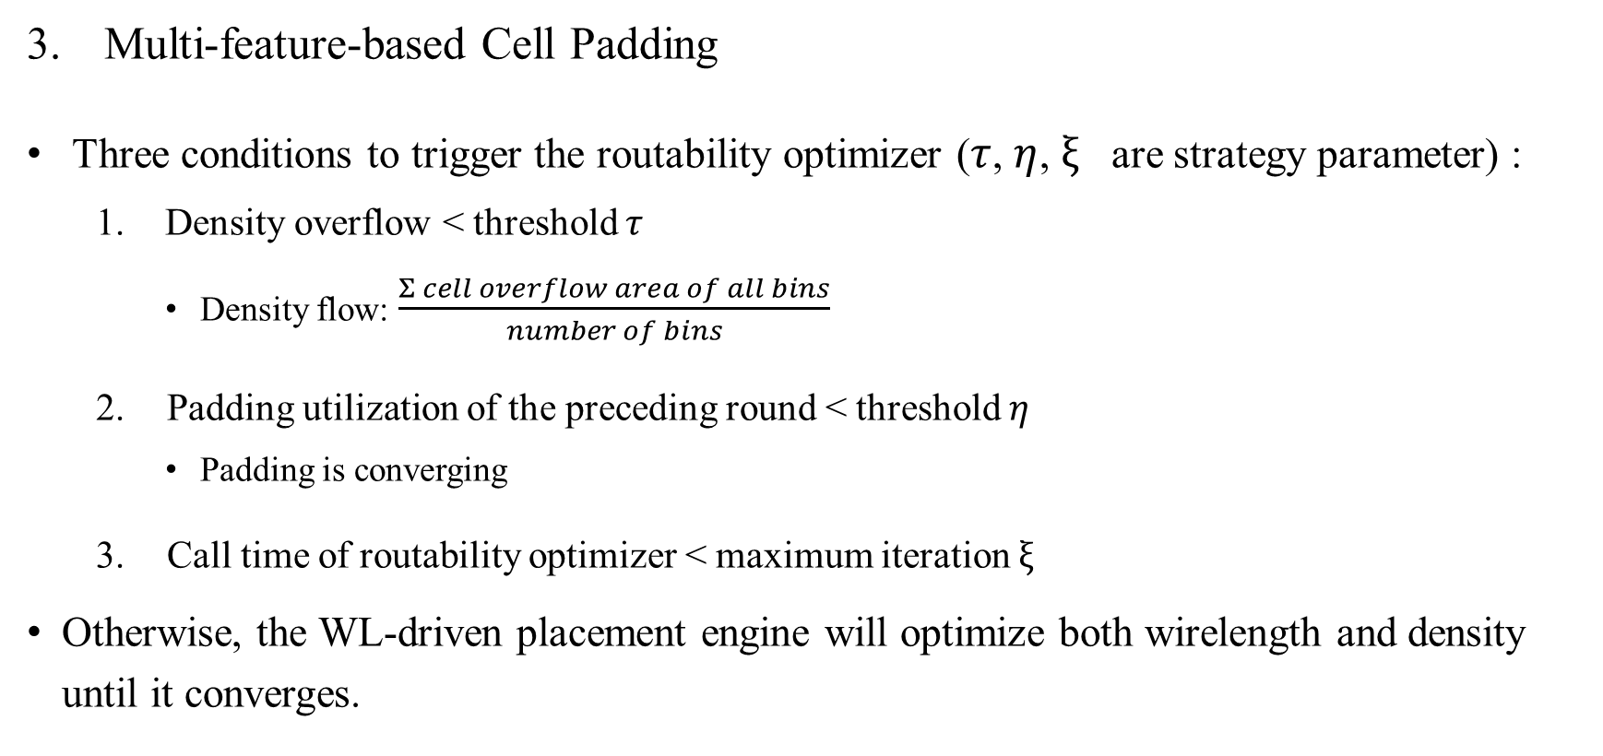
Cell Padding
Multi-feature-based Cell Padding
Three conditions to trigger the routability optimizer ($τ$, $η$, $ξ$ are strategy parameter) :
Density overflow < threshold $τ$
Density flow: $\frac{Σ cell overflow area of all bins}{number of bins}$
Padding utilization of the preceding round < threshold $η$
Padding is converging
Call time of routability optimizer < maximum iteration $ξ$
Otherwise, the WL-driven placement engine will optimize both wirelength and density until it converges.
Notes:
三個都要meet才會觸發
Cell overflow area 應該是該bin的面積可能是a，但是在這個bin所有cell的area總和會超過a，超過的部分就是cell overflow area

Slide 34
Outline
Abstract
Introduction
Preliminaries
Proposed Algorithm
Congestion Estimation
Cell Padding
Strategy Exploration
Legalization
Experimental Result

Slide 35
Strategy Exploration
Bayesian-based Strategy Exploration
In previous stage, several strategy parameter should be determined.
Placement can be considered as an evaluation-expensive black-box derivative-free
process.
Apply the sequential model-based global optimization (SMBO) with the tree-
structured Parzen estimator (TPE) approach [17].

Slide 36
Strategy Exploration
"Sequential Model-Based Global Optimization"（SMBO）是一種用於問題優化的方法，它結合了機器學習模型和全局優化策略，以尋找目標函數的最佳解。SMBO的關鍵思想是在每次迭代中使用一個模型來估計目標函數，然後利用這個模型來選擇下一個樣本點，以便在下一個迭代中進行評估。這個迭代過程會持續，直到找到滿足一定條件的最佳解或達到預定的迭代次數。SMBO通常包括以下關鍵組件：Surrogate Model（代理模型）：SMBO使用代理模型來近似目標函數。這個代理模型可以是高斯過程（Gaussian Process）、隨機森林（Random Forest）或其他回歸模型。代理模型估計了目標函數的值，並提供不確定性度量。Acquisition Function（收集函數）：收集函數是用於選擇下一個樣本點的策略。它基於代理模型的預測和不確定性來權衡探索（尋找未知區域）和利用（在已知良好區域內繼續搜索）的權衡。Initialization（初始化）：SMBO需要一些初始樣本點，以啟動優化過程。這些樣本點通常是隨機選擇的，或者可以使用先前的經驗數據。Termination Criteria（終止條件）：SMBO必須定義一個終止條件，以確定何時停止迭代。這可以是達到預定迭代次數、找到足夠好的解或其他條件。SMBO的主要優點是它能夠在高維、複雜、昂貴的黑盒優化問題中找到全局最優解，而無需導數信息。它在許多領域，如超參數調優、自動機器學習和工程設計中都有廣泛的應用。
順序模型全域最佳化（SMBO）是一種最佳化方法，用於尋找複雜問題中的全域最優解。它採用了一種迭代的策略，結合了機器學習模型和全局搜索，以逐步逼近最佳解。在SMBO中，樹狀結構的Parzen估計器（TPE）方法被應用。 TPE是一種估計機率分佈的方法，用於建模目標函數的分佈。它透過建立兩個機率分佈，一個用於表示優化目標較好的樣本，另一個用於表示不太好的樣本。這兩個分佈的比值將指導下一個樣本點的選擇，以平衡探索和利用。 SMBO與TPE的結合使得優化過程更加智慧和有效率。它在每次迭代中使用TPE來選擇下一個樣本點，以盡量減少目標函數的估計不確定性，從而更有可能找到全域最佳解。這種方法特別適用於那些目標函數難以建模的問題，因為它不需要目標函數的具體數學表達式，而是依賴樣本點的評估結果來指導搜尋。 總之，SMBO與TPE的結合是一種強大的全域最佳化方法，適用於各種領域，包括超參數調優、自動機器學習和複雜工程設計等。它可以幫助在高維、複雜問題中找到最佳解決方案，而無需詳細的問題知識。

Slide 37
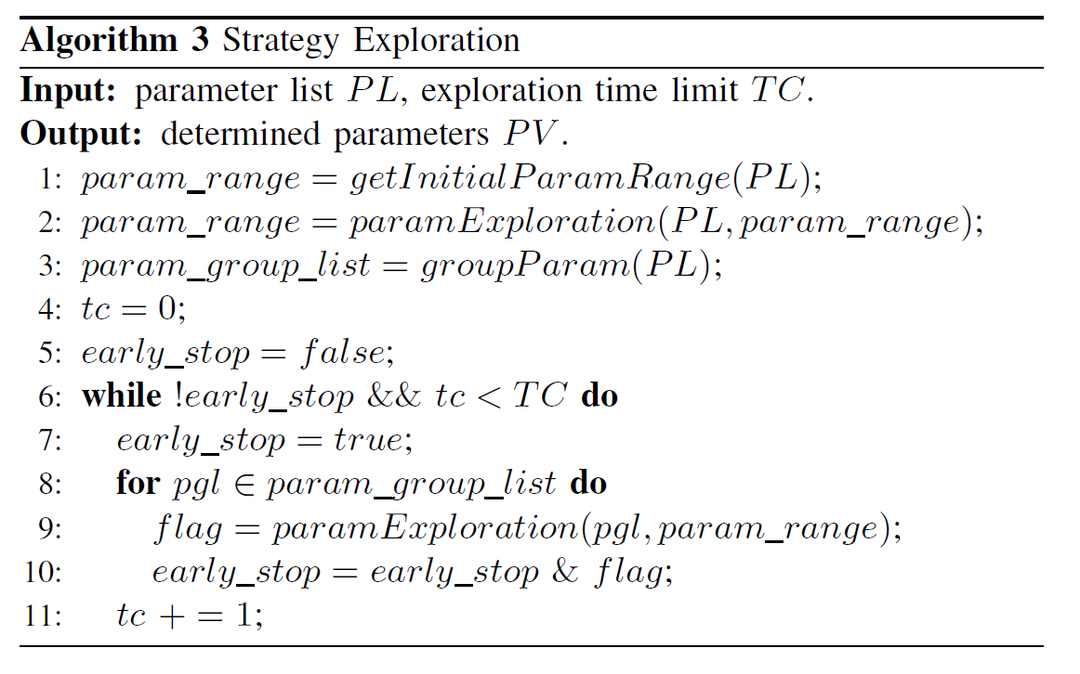
Strategy Exploration
Bayesian-based Strategy Exploration
Notes:
這個algorithm3 是有關於他們strategy exploration的計畫，包含兩個部分: 1. global exploration跟2. local exploration
Tc: 現在執行的iteration數
1-2 : 先給定所有parameter一個range，接著所有參數一起跑剛剛講的parameter exploration
3: 接著會將parameters分組，有強相關的會分再一起
6-11: 接著會將分組過後的進行parameter exploration，而不屬於該組的parameters的就會用他們自己range的中位數
當全部跑完後(可以平行)就會得到所有paramete最後的range，接著該parameter就會用那個range的中位數當作最後的值

Slide 38
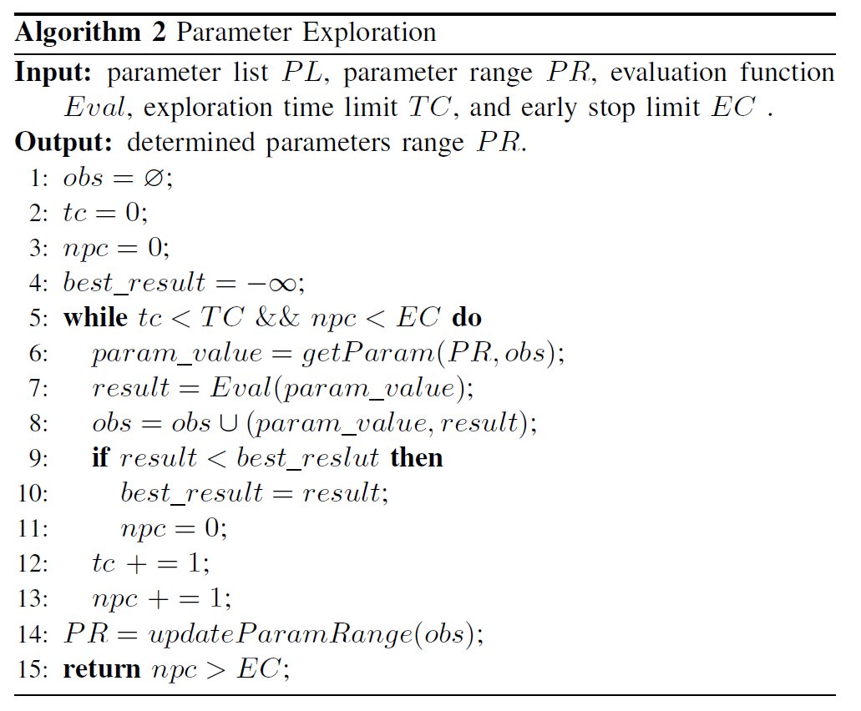
Strategy Exploration
Bayesian-based Strategy Exploration
Notes:
這個algorithm 2 是有關於parameter exploration
Obs : 用來記錄參數數值跟result的
Tc: 現在執行的iteration數, Npc: 結果沒有improve的次數
Parameter list 是給discrete的參數的，parameter range是給continuous的參數的
6: 會從range跟obs(結果)來找一個範圍

Slide 39
Outline
Abstract
Introduction
Preliminaries
Proposed Algorithm
Congestion Estimation
Cell Padding
Strategy Exploration
Legalization
Experimental Result

Slide 40
Legalization
White-space-assisted Legalization
After global placement, we need to place the cell in legal position to eliminate overlaps and DRVs.
Inherit the padding from global placement to introduce white space in the congested region.
To control the padding utilization, we limit the total padding area to less than 5% of the total movable cells area.
After adding the cell padding, they employ Abacus-based algorithm for legalization.

Slide 41
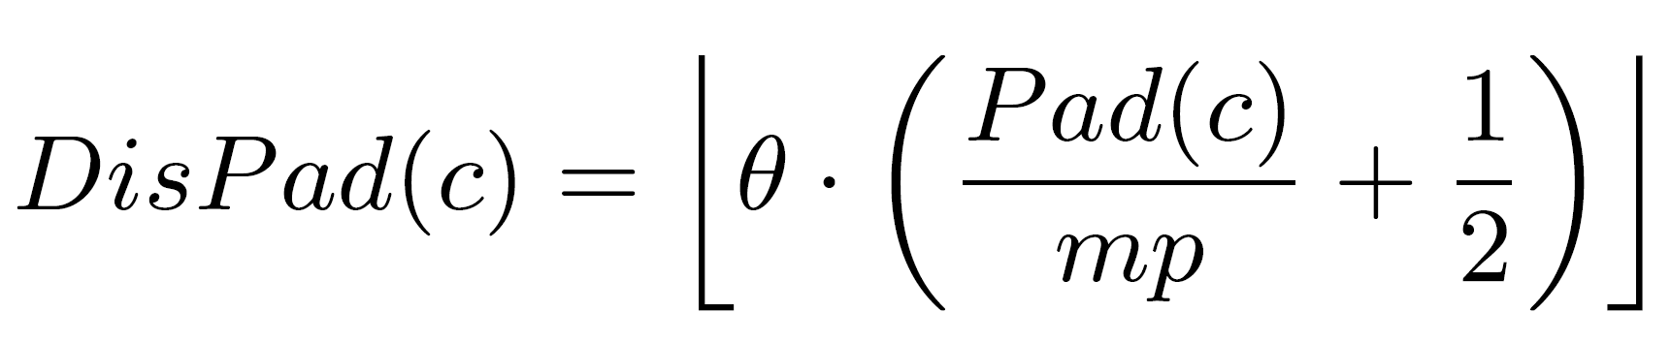
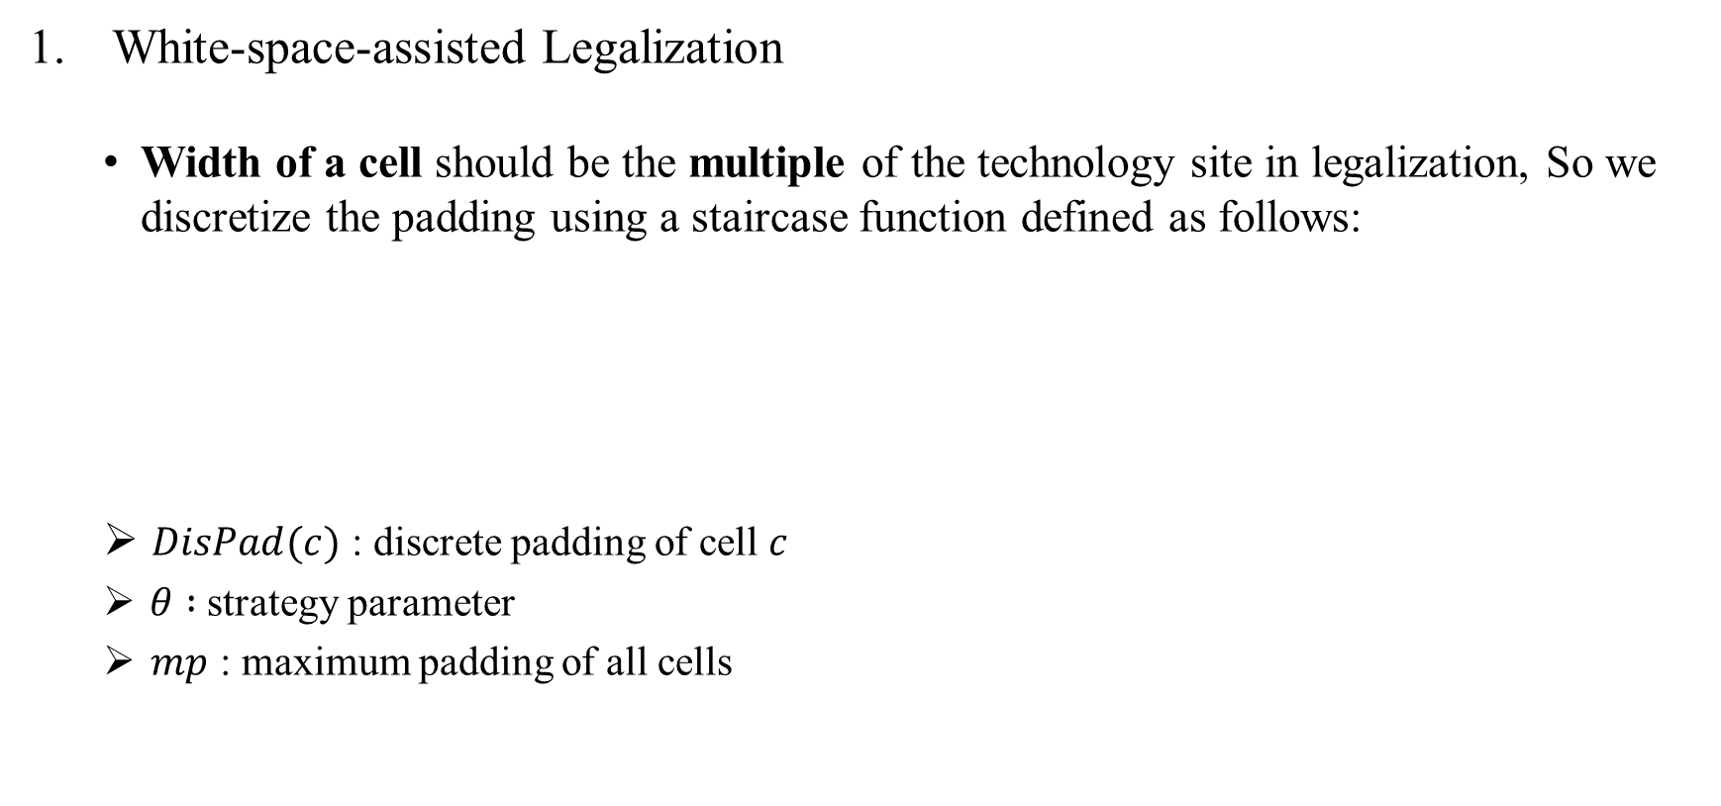
Legalization
White-space-assisted Legalization
Width of a cell should be the multiple of the technology site in legalization, So we discretize the padding using a staircase function defined as follows:
$DisPad(c)$ : discrete padding of cell $c$
$θ :$strategy parameter
$mp$ : maximum padding of all cells
Notes:
如果total padding超過Limit的話，他們會在discrete padding中挑最小的的padding來釋放他，直到meet constraint

Slide 42
Outline
Abstract
Introduction
Preliminaries
Proposed Algorithm
Congestion Estimation
Cell Padding
Strategy Exploration
Legalization
Experimental Result

Slide 43
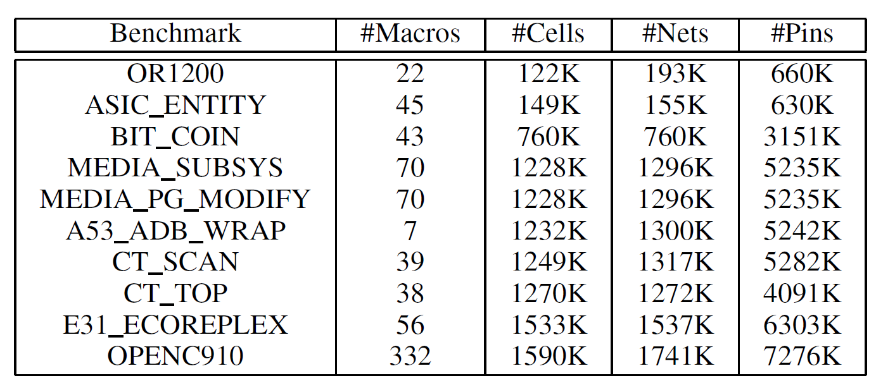
Experimental Result
Environments
C++ language.
64-bit CentOS Linux .
Intel® Xeon(R) Platinum 8260 CPU @ 2.4GHz , using 8 thread.
Benchmarks

Slide 44
Experimental Result
They compare their proposed framework PUFFER with RePlAce and innovus.
Utilize the global router of Innovus to evaluate the routability of the placememt result.
They take 1% overflow as the pass criterion for routability.
Notes:
因為1%-2%在後續的優化可以修掉

Slide 45
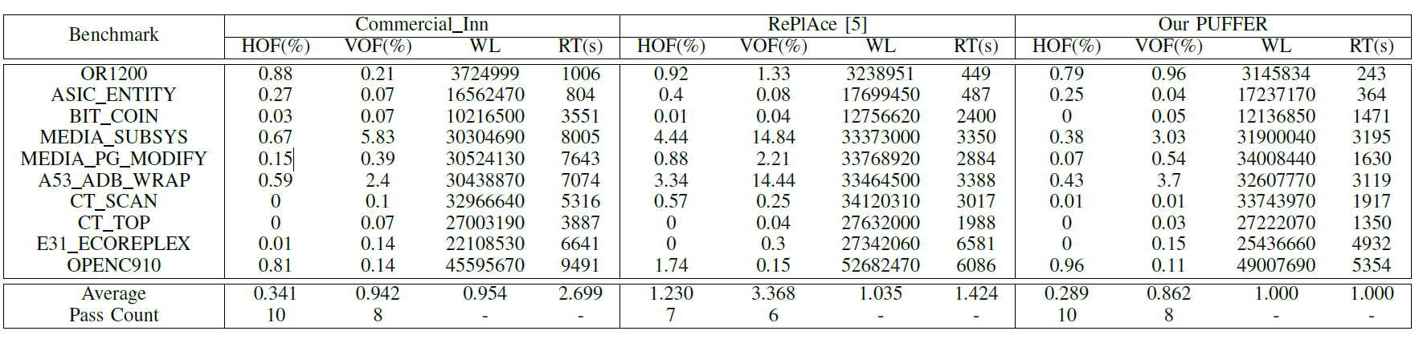
Experimental Result
2.7x
1.4x
1.045x
HOF : routing overflow ratio of horizontal direction
VOF : routing overflow ratio of vertical direction
WL : global routing wirelength
RT : runtime
Notes:
這個algorithm3 是有關於他們strategy exploration的計畫，包含兩個部分: 1. global exploration跟2. local exploration
1-2 : 先給定所有parameter一個range，接著所有參數一起跑剛剛講的parameter exploration
3: 接著會將parameters分組，有強相關的會分再一起
6-11: 接著會將分組過後的進行parameter exploration，而不屬於該組的parameters的就會用他們自己range的中位數
當全部跑完後(可以平行)就會得到所有paramete最後的range，接著該parameter就會用那個range的中位數當作最後的值

Slide 46
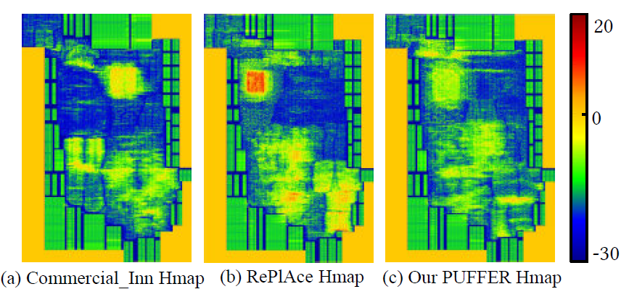
Experimental Result
Notes:
Horizontal congestion map

Slide 47
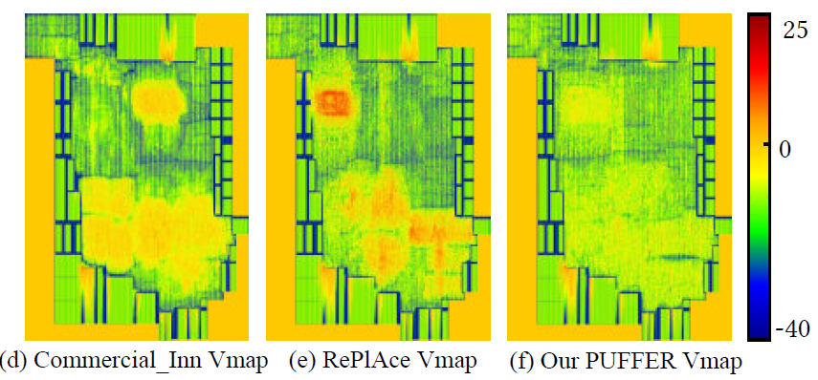
Experimental Result
Notes:
Vertical congestion map

Slide 48
Thank you for listening!

Slide 49
1. recycle
2. Detour-imitating Routing Demand Expansion
3. 3個condition

